Slide 1
AI projects
Project 1: Search algorithms (25 points).
Question 1,2,3 and 4 are mandatory (12 points).
Question 5,6,7 and 8 are optional (13 points).
Project 2: Multi-Agent search (25 points).
Question 1,2,3 and 4 are mandatory (19 points).
Question 5 is optional (6 points).

Slide 2
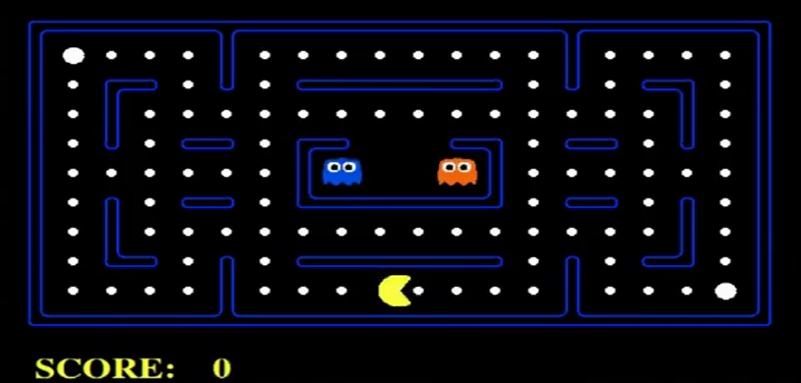
Adversarial search

Slide 3
Adversarial search
To eat all the food dots and avoid the Ghosts you need:
Appropriate search algorithm (question 2,3 and 4).
MinMax
Alpha-Beta Pruning.
Expectimax
Good evaluation function (question 1 and 5).
How good or bad is your state ?.

Slide 4
Conclusions
Send your report and your code to zinelabidine.boulkenafet@oulu.fi by 22/02/2018.
The projects can be done individually or in a team of 2 or 3 students.
Think about the use of the recursive function in your implementation.

